Slide 1
Applied Data Science Capstone Final Project Battle of the Neighborhoods Exploring New York City
By: Dawn Tran
December 2020

Slide 2
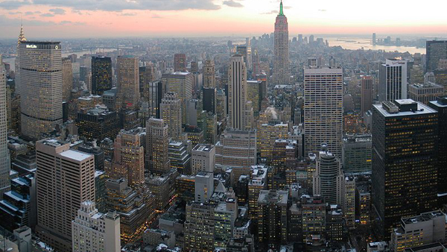
New York City

Slide 3
Business Problem
Due to this demand and the growth of the travel accommodation, Travel agency starting a project of preparing a list of hotels, restaurants, coffee shops along with the name, address, location and the map for their clients. So that their clients can be prepare prior to their visits and know to what to do and where to go when they arrived in New York City – the City that never sleep.
This project is particularly useful for those visitors / tourists that is the first-time visiting New York City or a re-visit after many years
This is specifying for Manhattan borough of New York City, since it attracted most of the tourists every year.

Slide 4
Data
Data required
List of borough and neighborhoods of New York City
Latitude and Longitude coordinates of those neighborhoods
Venue data, particularly data that related to hotels, restaurants and coffee shops
Sources of data
- Open source dataset of New York City: https://cocl.us/new_York_dataset
- Geocoder package for latitude and longitude coordinates
- Foursquare API for venue data

Slide 5
Methodology
Collect the data from https://cocl.us/new_york_dataset, clean and process the data into a dataframe. Which included neighborhoods, along with latitude and longitude of Manhattan, New York City.
Using FourSquare API, searching the query for a list of hotels, restaurants and coffee shops within 1000 meters around Manhattan area.
Convert the data in to dataframe
Visualize the data into a graph by using python matplotlib libraries

Slide 6
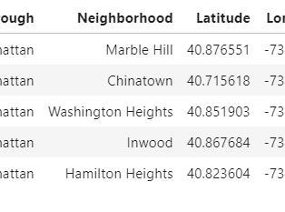
Exploring Manhattan Borough
Since this project is concentrating in Manhattan area, so let’s look at the data of this borough including the latitude and longitude of each neighborhoods
Here is the example of the list of data for Manhattan

Slide 7
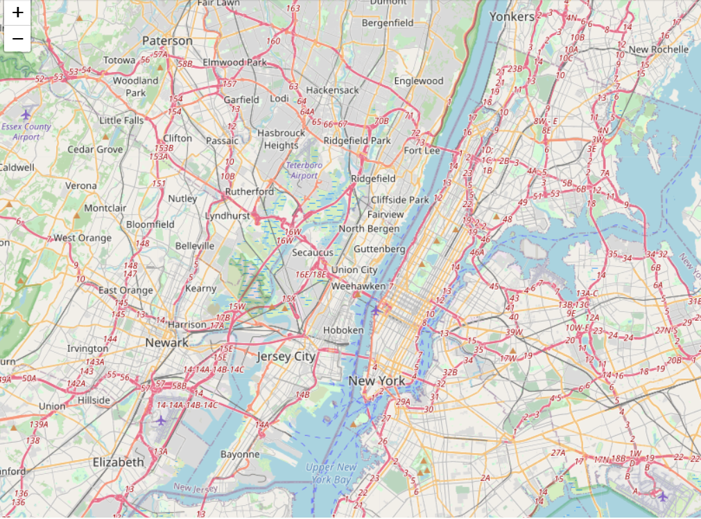
Exploring Manhattan Borough – Cont.
Here is map of Manhattan borough for tourists to get familiar with

Slide 8
Results
FourSquare API was used as a source for collecting venue data, particular venues that are related to hotel, restaurant and coffee shop near by Manhattan area
List of hotels, restaurants and coffee shops were collected, which included name, address, latitude and longitude values.
Maps were plotted along with hotel, restaurant and coffee shop locations on them
These list of data's and maps for each venue will be provided to the tourists prior to their trips so that they can get prepared

Slide 9
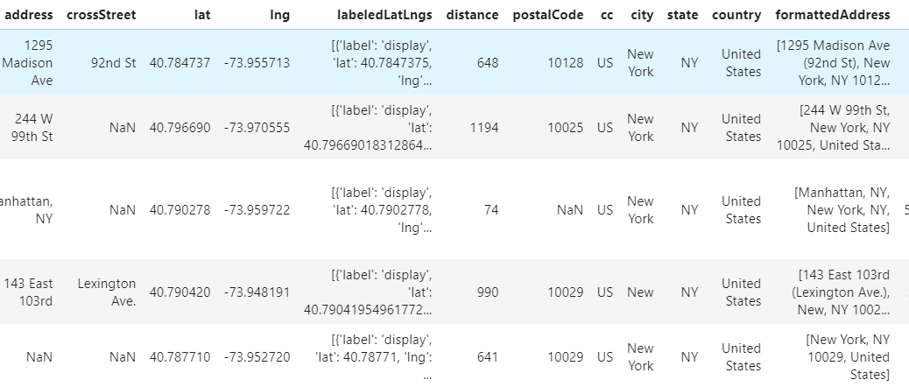
Results – Hotels Data
Here is the example of a list of hotels that were collected from FourSquared API

Slide 10
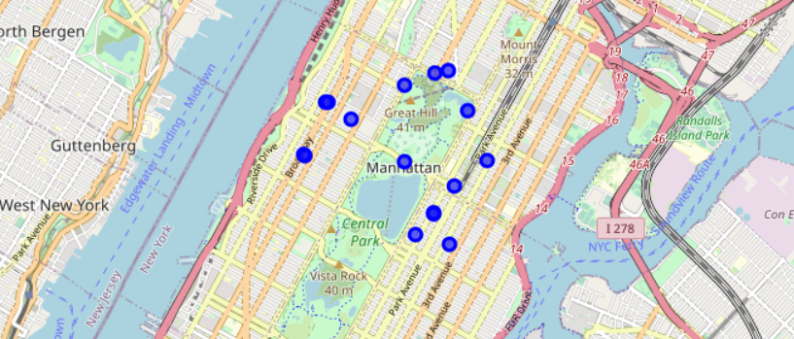
Results – Hotels Map
Here is the example of the Manhattan map that has the hotel locations on it

Slide 11
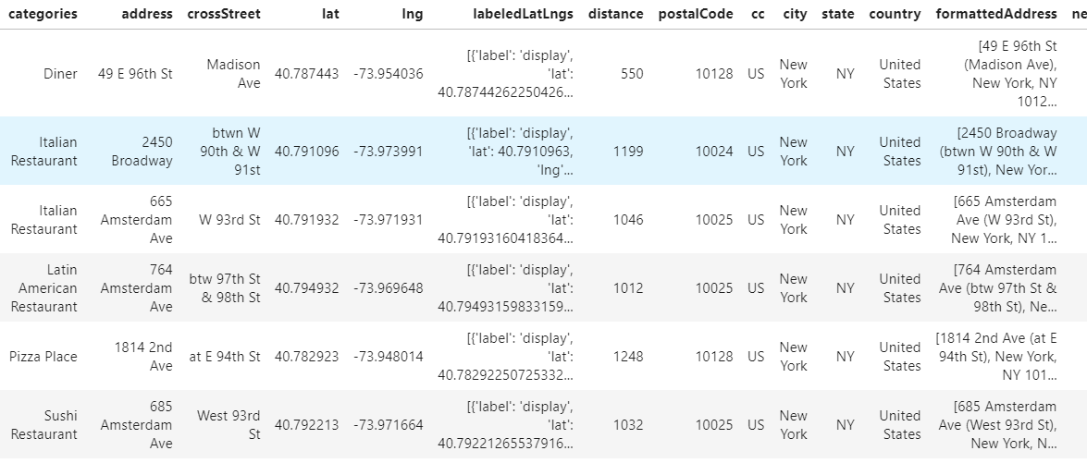
Results – Restaurants Data
Here is the example of a list of restaurants that were collected from FourSquared API
There are many different types of food chain for tourists to choose

Slide 12
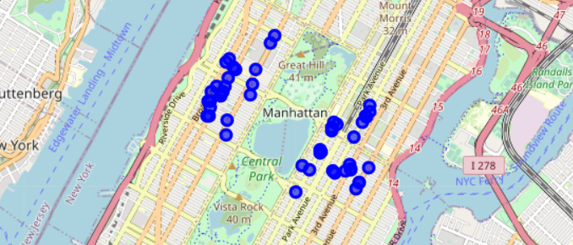
Results – Restaurants Map
Here is the example of the Manhattan map that has the restaurant locations on it

Slide 13
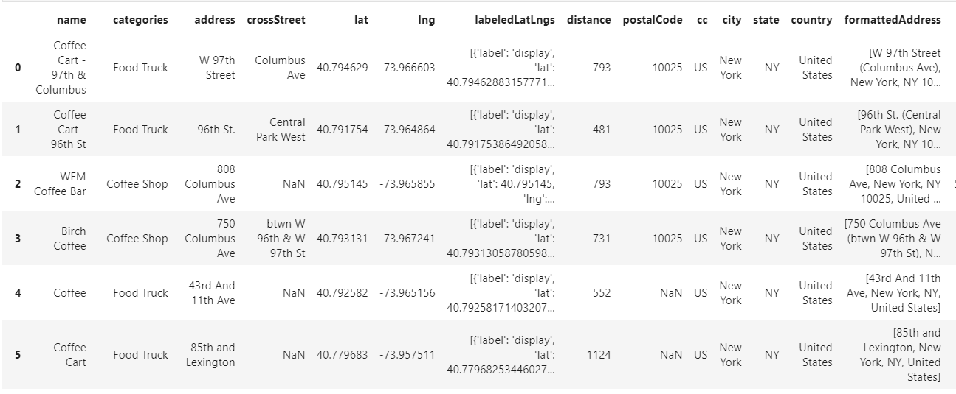
Results – Coffee Shops Data
There are also many coffee shops around Manhattan area for tourists to enjoy
Here is the example of a list of coffee shops nearby

Slide 14
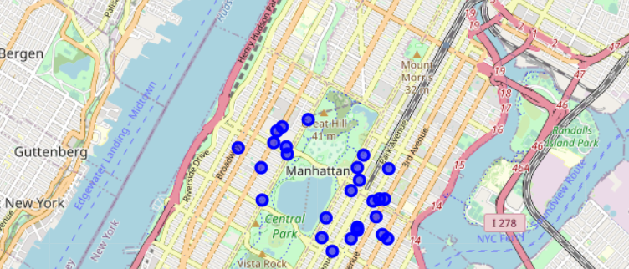
Results – Coffee Shops Map
Here is the example of the Manhattan map that has all coffee shop locations on it

Slide 15
Results and Discussion
16 Hotels were found nearby Manhattan borough of New York City
50 Restaurants were found nearby Manhattan, they are all different variety and diversity of the food chains to choose from, such as Japanese, Mexican, Chinese, Italian and etc..
27 Coffee shops were found nearby Manhattan
There are plenty of choices for tourists to choose from while they are planning a trip to Manhattan of New York City
These information will be very helpful for tourists to plan their trips

Slide 16
Conclusion
With these data, travel agents be able to provide all the information to their clients prior to their trip. Hence, tourists can be able to save some of their time and efforts from searching information on their own and be able to enjoy their stay and have a great time visiting Manhattan, New York City.

